Slide 1


Data Science Interview Prep
Workshop Series #6

Slide 2








Berkeley Data Science Panel 2017
- Marketing & Advertising -
Saturday, Nov 18th
Li Ka Shing Auditorium
12:30 PM - 6:00 PM
8 speakers
2 networking sessions
Food provided
RESUME DROP Available
Purchase ticket @ bit.ly/2hzywkr
PROMO: DSMEMBER17

Slide 3

Data Science Society at Berkeley
Instructors + LA’s

Slide 4

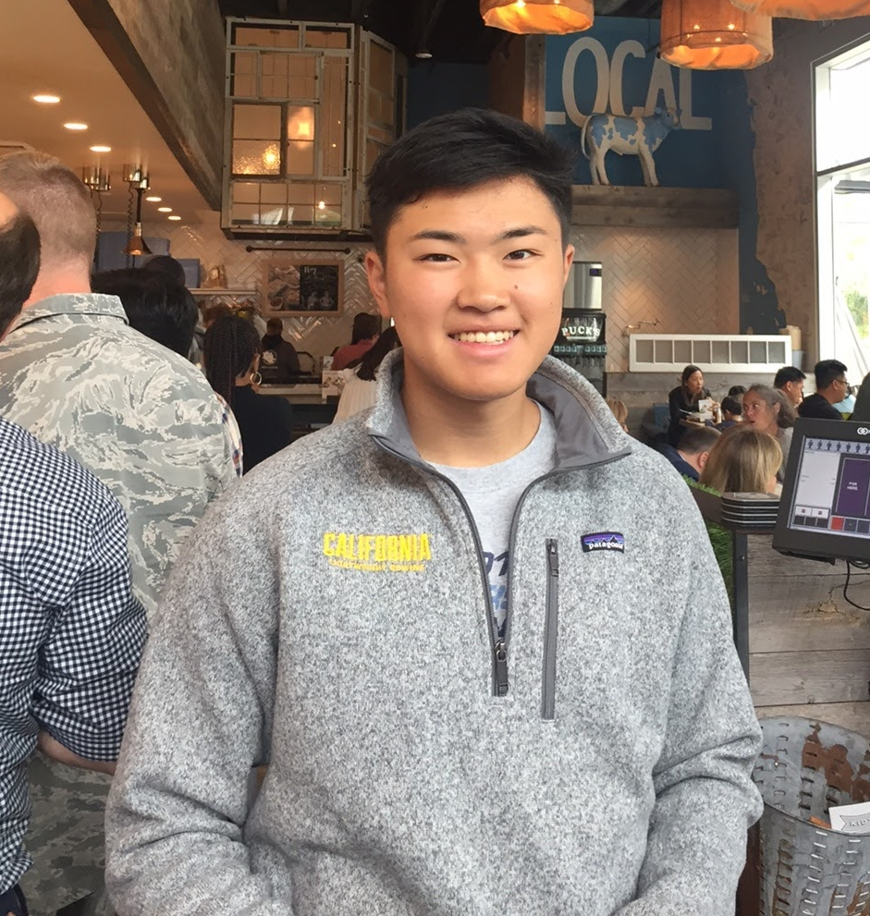
Instructors
Alex Nakagawa alex.nakagawa@berkeley.edu
Sophomore
Computer Science & Cognitive Science
Heather Chen
heatherchen116@berkeley.edu
Senior
Applied Mathematics & City Planning
Notes:
Quick introductions, some interesting facts
Talk about how we got interested in data science
Encourage questions!

Slide 5
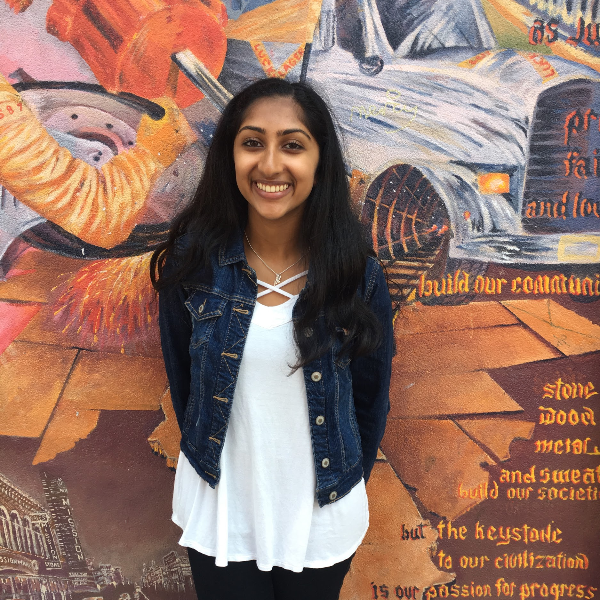

Instructors
Shalini Kunapuli
Nicole Chen
Notes:
Quick introductions, some interesting facts
Talk about how we got interested in data science
Encourage questions!

Slide 6

Data Science Society at Berkeley
Lesson Plan

Slide 7
Lesson Plan
The Complete Package
Recruiting
Resume Critique
The Interview
Presenting Yourself
Practice Questions
Notes:
+heather

Slide 8
Software Engineering vs. Data Science Interview
Software Engineering
Java, C
Emphasis on the hard coding skills
Algorithms
Coding
Data Science
SQL, Python, R
Analysis
Product
Probability
Interdisciplinary
Machine Learning
Notes:
heather

Slide 9
Data Science Interview Workshop: 1
The Complete Package
Notes:
@ 7:30 +alex

Slide 10




The Complete Package
Recruiting
Resume
Interview

Slide 11
Data Science Interview Workshop: 1
Recruiting

Slide 12



Online Presence
Spreading your name to the far reaches of the internet
LinkedIn
Glassdoor
Piazza (!)
Personal website (blog)
What kind of job are you looking for? Startup? Big tech firm?
Glassdoor
LinkedIn
Handshake
Company websites
Notes:
alex
equally important is your presence online
piazza is actually quite important! lists all your skills there too, companies do searches there

Slide 13
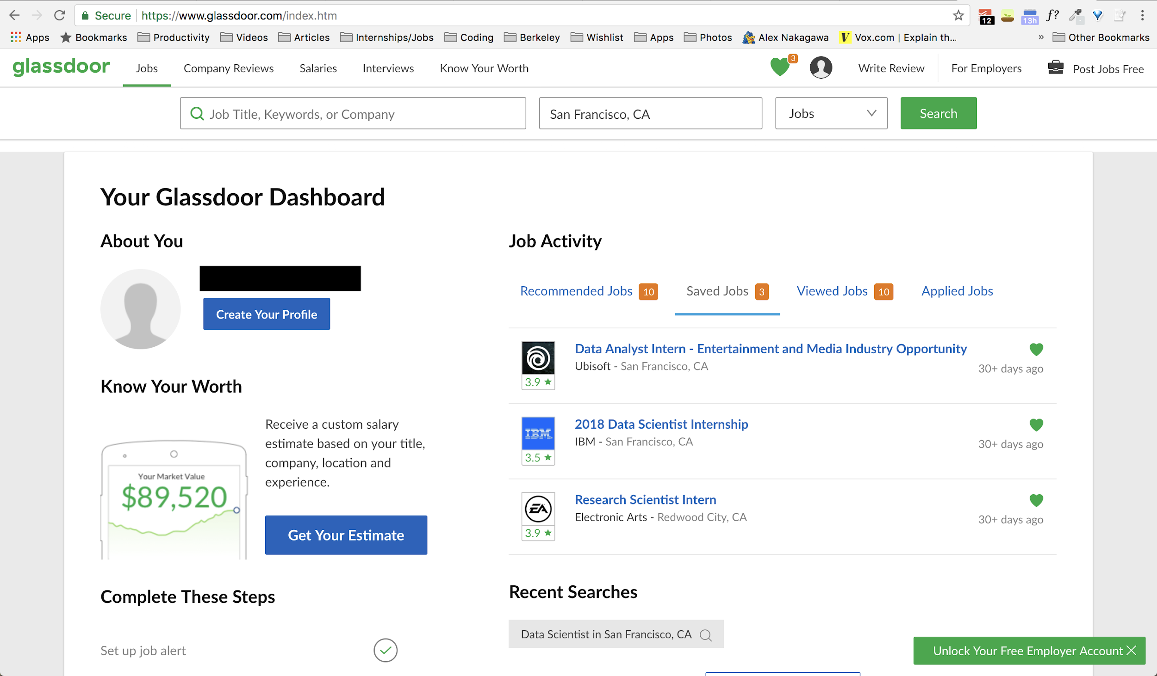
Online Presence
Notes:
+alex

Slide 14
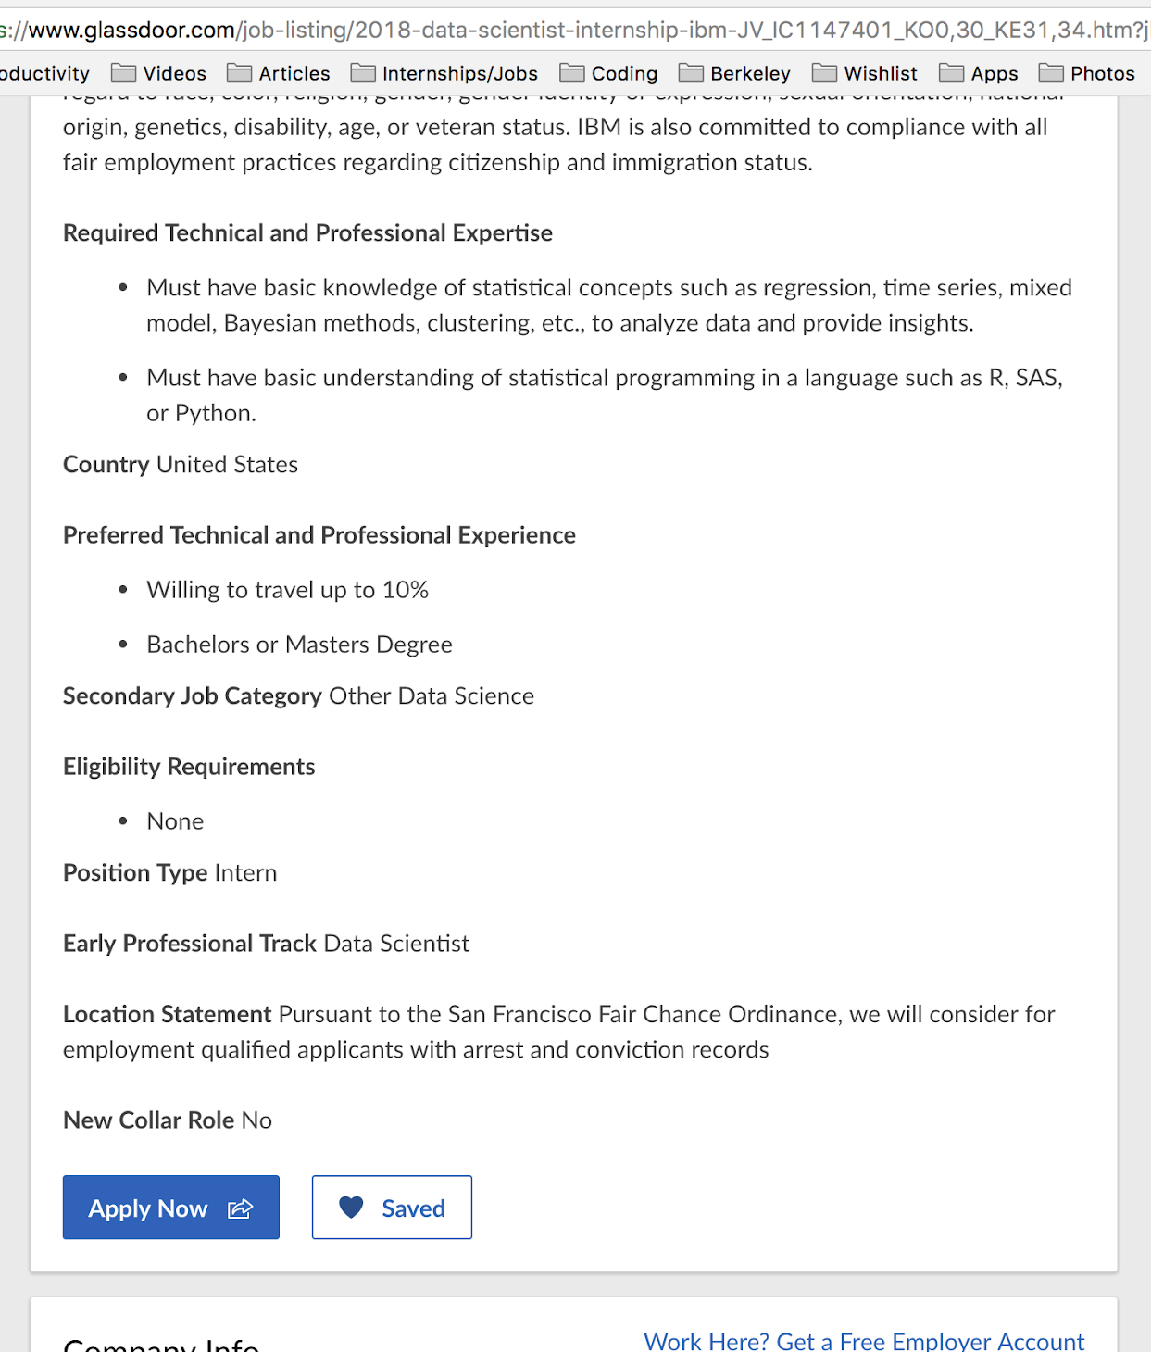
Online Presence
Be aware of the qualifications
Don’t be afraid to email or ask if you don’t fulfill a specific required skill.
If not, sharpen skills in that area
Notes:
+alex

Slide 15
Networking
Spreading your name to the far reaches of the REAL world
Career Fairs
Never too early!
Understand what recruiters are looking for
Specific questions (ML focused? Analytics? Business-level? Consulting?)
Meet-ups/Tech Talks
BIDS (https://bids.berkeley.edu/events)
Various clubs around campus (Data Science Society, ML@B)
Meetup (https://www.meetup.com/SF-Data-Science/)
Notes:
+alex
Understanding what recruiters are looking for will help you shape what you’re looking for
Have a set goal in talking to recruiters

Slide 16
Data Science Interview Workshop: 1
Size of company?
FOCUS your story.
Type of data scientist?
Product?
Notes:
+heather
software dev? data analytics? business?
small company or big company?
what kind of position are you looking for?
why do you want to work here?
what can the company do for you?
internships are very much a giving opportunity

Slide 17
Data Science Interview Workshop: 1
How do people perceive you?
What is your goal?
What makes you EXCEL?
Example 1:
excited to learn
gets things done
great at communication
Example 2:
reliable
flexible
great at prioritizing and balancing tasks
Personal branding
Goal: to be easily memorable
Notes:
branding yourself will help make you more memorable
going into the conversation with a focus in what kind of person you want to portray
will help them remember those traits

Slide 18
Data Science Interview Workshop: 2
Resume
Notes:
purpose: to tell a STORY in order to get an interview! only include relevant details
this is not a FILL YOUR RESUME WITH EVERY SINGLE THING YOU CAN DO
make it look like THIS is everything you want, specialize your resume

Slide 19
What to include:
Education
Technical Skills
Professional Experience
Projects
Notes:
no professional experience? no problem
do personal projects! kaggle! just show curiosity, like alex mentioned before
come up with an idea regarding something you care about
acquiring the data
analyzing it
online courses

Slide 20
Qualities of a Strong Data Science Candidate
Math/statistics
Business
Database/programming
Communicating results/insights
Curious
Works well in teams and under pressure

Slide 21
Your turn!
Now that we’ve given you some tips on how to sell your story, find someone around you and give them your 30 second pitch. Have fun! :)
why you’re interested in data science
your strongest skills
current/past projects
what makes you awesome
what makes you unique
topic suggestions:

Slide 22
Data Science Interview Workshop: 3
Interview
Notes:
+alex

Slide 23
Interview
General Structure:
Introduction to the company
Problem-solving, personal skills
Technical Dive
Questions
https://medium.com/@skyetetra/hiring-data-scientists-my-interview-questions-56d5ae3fc621
Notes:
in the perspective of the interviewer

Slide 24
Interview
Technical Dive
Types of Questions
Open-ended Analysis
Implementation/
Complexity (Software)
Machine Learning
Notes:
+alex

Slide 25
Interview
Question 1 (SQL)
Given two tables: Facebook_friend_request(requestor_id, sent_to_id, time) and Facebook_request_accepted (acceptor_id, requestor_id, time), find the overall acceptance rate of requests.
Notes:
SELECT * FROM ffr LEFT OUTER JOIN fra ON ffr.requestor_id = ffa.requestor_id (OR ffr.sent_to_id = ffa.acceptor_id)
you want the number of matched ones over total
SELECT (SELECT count(*) from joined where acceptor_id is not null) as accepted, count(*) FROM joined

Slide 26
Interview
Answer
WITH joined AS SELECT * FROM ffr LEFT OUTER JOIN fra ON ffr.requestor_id = ffa.requestor_id (OR ffr.sent_to_id = ffa.acceptor_id)
SELECT (SELECT count(*) from joined where acceptor_id is not null) as accepted, count(*) FROM joined;
edit: also can just get total of acceptances / count of total :)
Notes:
WITH joined AS SELECT * FROM ffr LEFT OUTER JOIN fra ON ffr.requestor_id = ffa.requestor_id (OR ffr.sent_to_id = ffa.acceptor_id)
SELECT (SELECT count(*) from joined where acceptor_id is not null) as accepted, count(*) FROM joined

Slide 27
Interview
Statistics Concepts
p-value
confidence intervals
hypothesis testing
bootstrap sampling
Monte Carlo Simulation
Central Limit Theorem
Law of Large Numbers
Notes:
WITH joined AS SELECT * FROM ffr LEFT OUTER JOIN fra ON ffr.requestor_id = ffa.requestor_id (OR ffr.sent_to_id = ffa.acceptor_id)
SELECT (SELECT count(*) from joined where acceptor_id is not null) as accepted, count(*) FROM joined

Slide 28
Interview
Question 2 (DS for Businesses)
Our small Airbnb-type startup is trying to understand discounts for their bookings. As the lead (and only) data scientist on the team, how would you go about creating a report for this? What questions can you ask?
Assume access to ~3 years worth of data and a couple thousand users.
Notes:
What percent of revenue are we losing due to discounts every month?
What kinds of people are using discounts? Are they first time users? Repeat users?
Are discounts incentivizing people to make bookings?
Are discounts being abused? What types of discounts are they? Seasonal?
How many first time bookings are discounts?

Slide 29
Possible Answers
What percent of revenue are we losing due to discounts every month?
What kinds of people are using discounts? Are they first time users? Repeat users?
Are discounts incentivizing people to make bookings?
Are discounts being abused? What types of discounts are they? Seasonal?
How many first time bookings are discounts?

Slide 30
Data Science for Startups
KPI (Key Performance Indicators)
What is the goal of the company? What metrics will represent these goals?
How do you define engagement?
Churn rate?
Customer acquisition cost
Lifetime value
How does the product monetize?
Friction points of the product?

Slide 31
Interview
Question 3 (ML Focused)
Explain what a decision tree is and what it’s used for to a non-technical colleague.
BONUS: Describe the steps taken to implement a decision tree model in 1 minute. What are the merits to using a random forest model over a decision tree?

Slide 32
Interview
Possible Answer
In the end, the algorithm will create a tree where at each point, you can make one of two decisions.
Following a path leads to an ultimate decision.
The split points will be chosen to maximize the probability of a correct classification.
BONUS!
Calculation of entropy → figuring out which column to split → ID3 → Information to carry
Random forests avoid overfitting, minimize error due to variance, bias, good for deep trees
Notes:
discount type, date used,

Slide 33
Interview
Question 4 (EDA)
https://tinyurl.com/mhdataset

Slide 34
Machine Learning Questions
Interview
Implementing a decision tree
Gradient boosted tree algorithm
Regression/coefficient interpretation
Cross validation + information leakage
Logistic regression
Matrix Factorization
Notes:
alex

Slide 35
Resources + Additional Content
Interview
https://medium.com/the-mission/how-to-break-into-the-data-science-market-f0e0b79b42f7
https://towardsdatascience.com/
https://www.dezyre.com/article/100-data-science-interview-questions-and-answers-general-for-2017/184
https://www.thedsinterview.com/
https://towardsdatascience.com/what-makes-a-good-data-scientist-at-a-small-company-3f445d421dff
https://medium.com/@skyetetra/hiring-data-scientists-part-1-2813ba44be9b

Slide 36
Feedback Form
https://tinyurl.com/interviewprep-dss

Slide 37
Thank you for coming!
Next week’s workshop is on:
DATA VIZ + TABLEAU

